Slide 1
01.12.2019
Azure DevOps CI/CD Crash Course
Jonathan Neo | Consultant

Slide 2

Facilitator notes
Create an Azure DevOps project (training) at the client’s tenant
Create a new Resource Group for training purposes
Add all training participants as contributors to the training Resource Group
Clone or zip the following repo and publish to Client’s Azure DevOps Training Repo: https://github.com/dotnet-architecture/eShopOnWeb
Follow the slides and do one end-to-end test run before the training

Slide 3


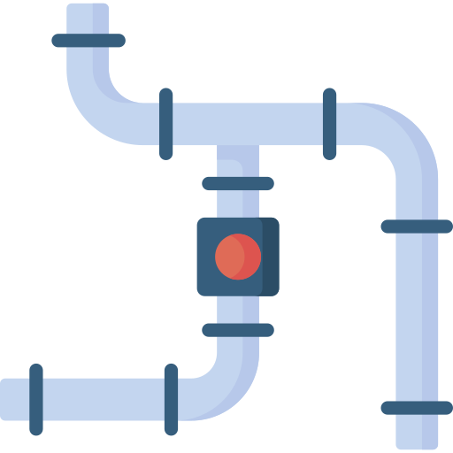
ADS Go Fast Training Sessions
Session 1 Git Crash Course
Session 2 Azure DevOps CI/CD Crash Course
Session 3 ADS Go Fast CI/CD

Slide 4
ADS Go Fast Training Sessions
Session 1 Git Crash Course
Session 2 Azure DevOps CI/CD Crash Course
Session 3 ADS Go Fast CI/CD

Slide 5
Agenda / navigation
Pre-requisites
Azure DevOps – Release
DevOps
Azure DevOps – DevOps Workflow
CI/CD
Azure DevOps – Workflow Exercise
Azure DevOps
Resources
Azure DevOps – Repos
Experience Sharing, Q&A
Azure DevOps – Build
Azure – Create Web Application

Slide 6


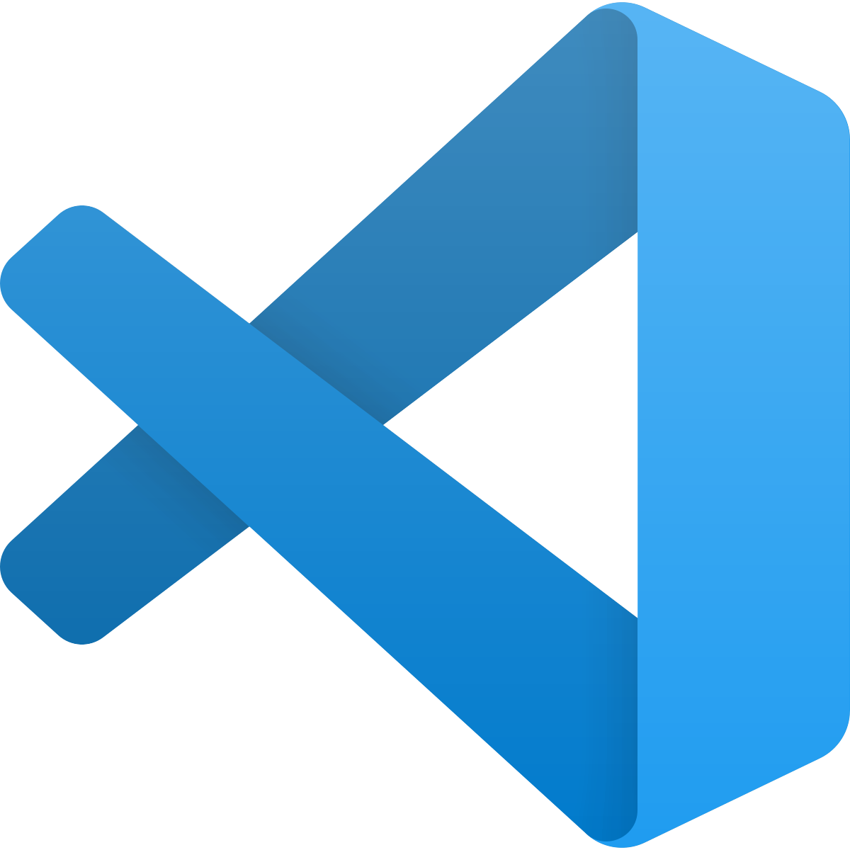
Pre-requisites
It is recommended that you have the following software installed on your computer so that you can follow along the exercises.
Git
Visual Studio Code
https://git-scm.com/downloads
https://code.visualstudio.com/download

Slide 7

Pre-requisites
Please verify that you have Contributor permissions to the training Azure Resource Group.

Slide 8
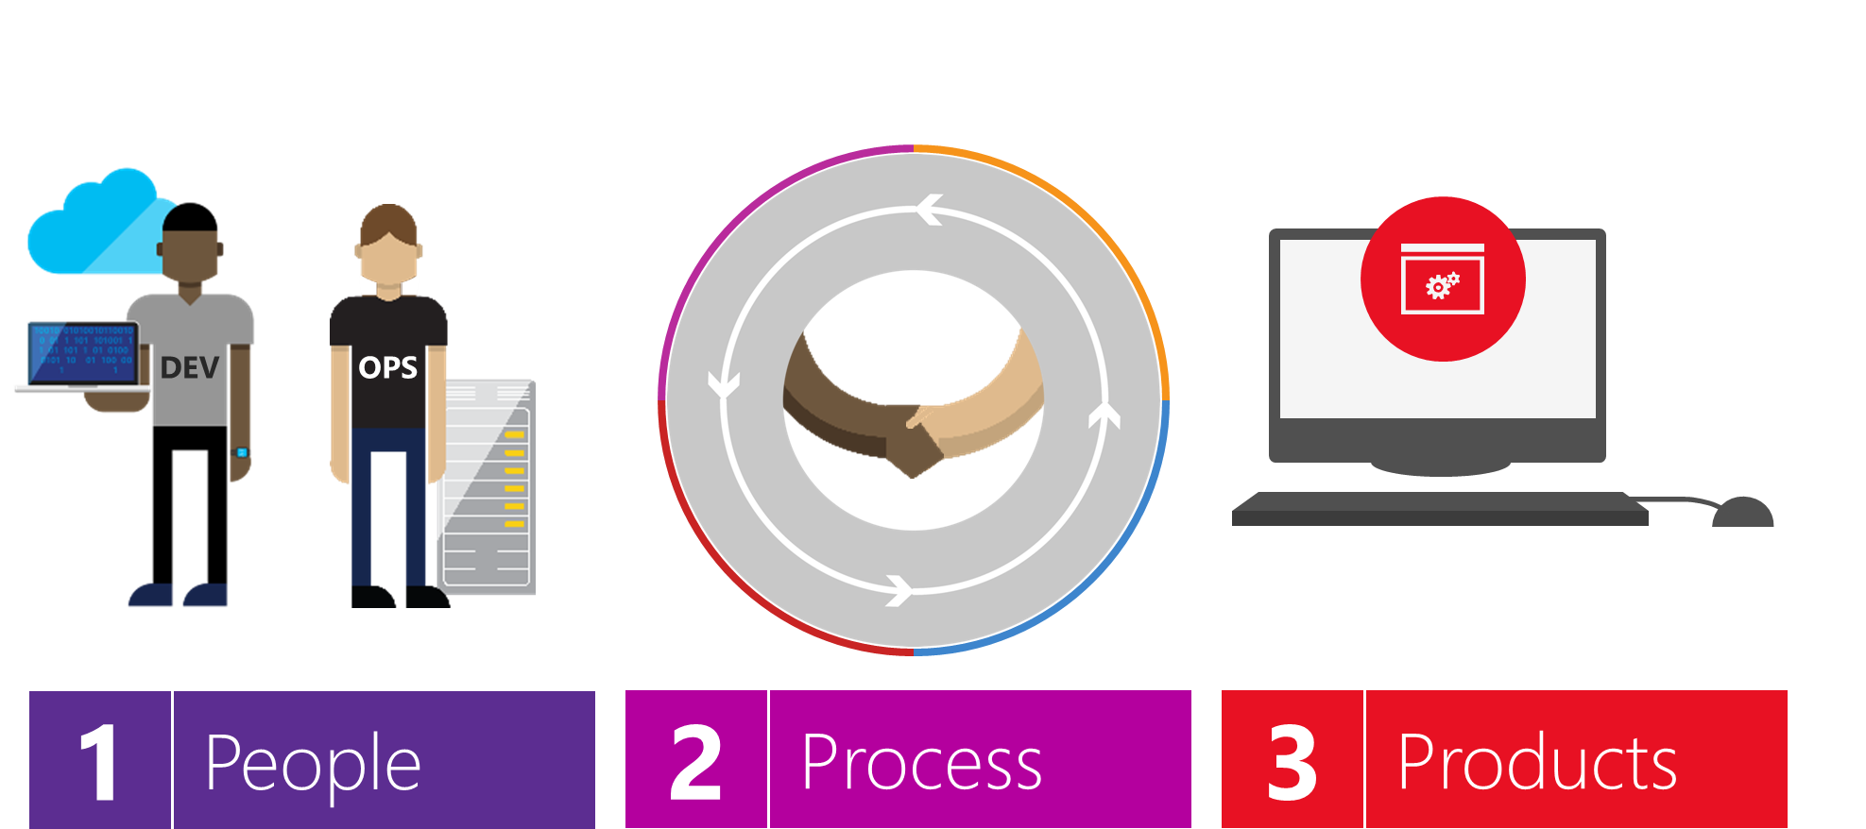
DevOps – What is it?
The combination of
To deliver value to end users

Slide 9
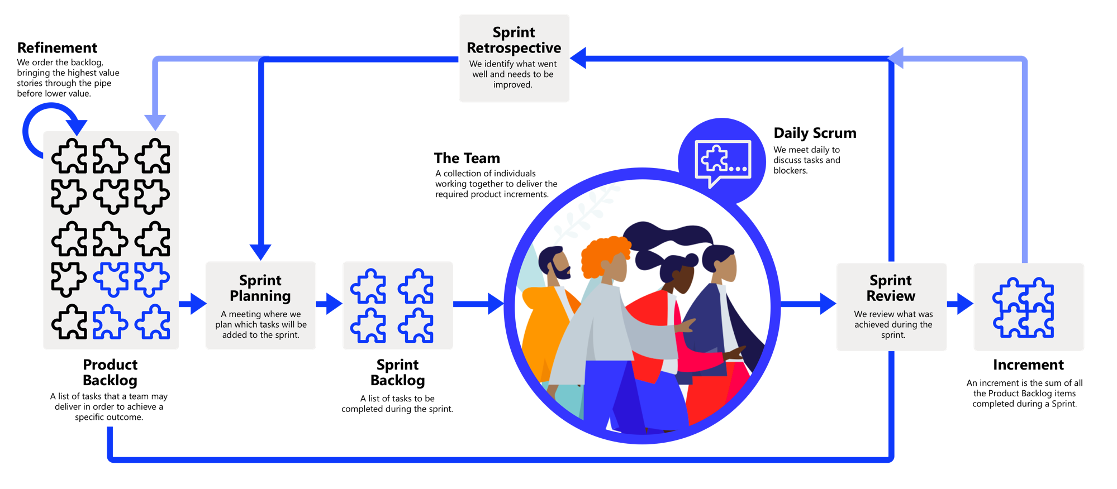

DevOps – What is it?
Deploy
DEV
OPS
Feedback

Slide 10

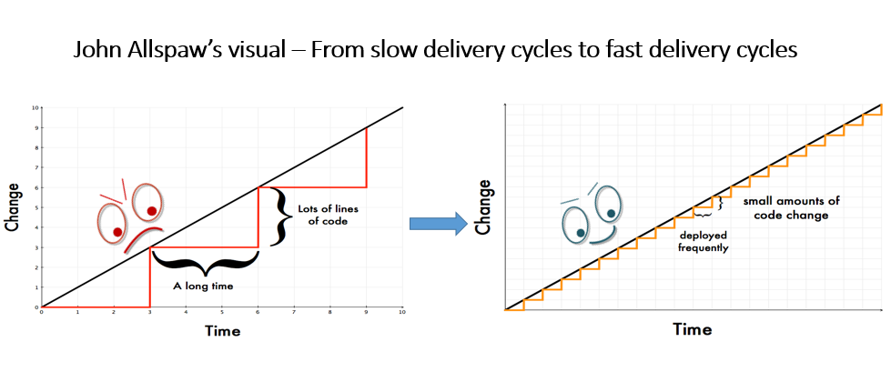
DevOps – Why do we need it?
Do you have war stories where you’ve tried to do things using the traditional approach and things ended up less than prefect?
Traditional Software Development
DevOps-led Software Development

Slide 11


DevOps – Common problems
We’ll explore how we can fix this problem using CI/CD.
Traditional Development and Operations
DEV
OPS

Slide 12
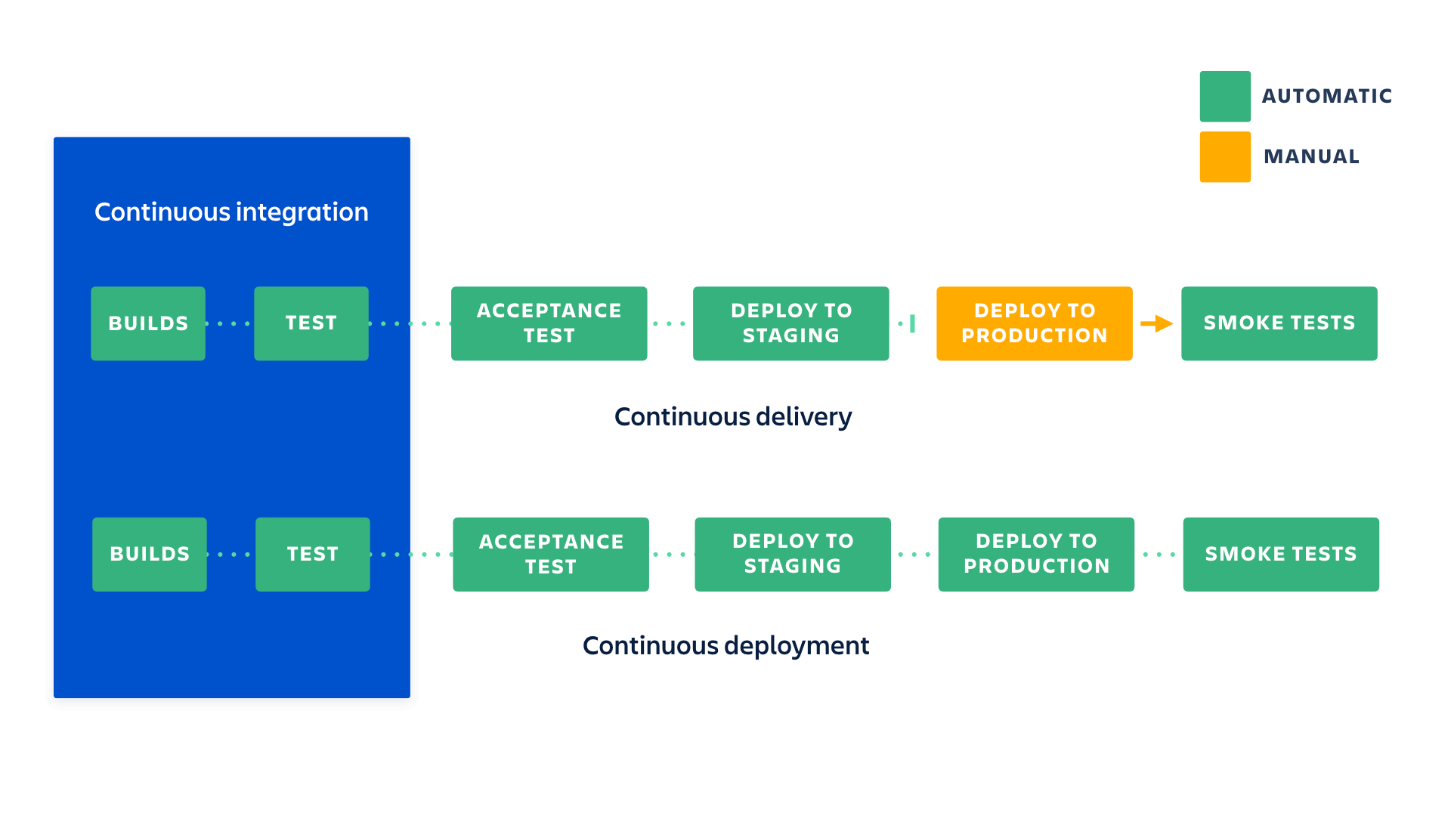
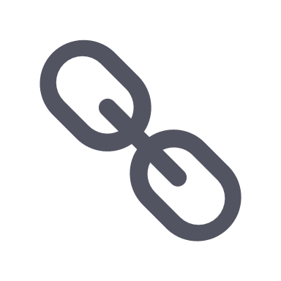
CI/CD
Source: https://www.atlassian.com/continuous-delivery/principles/continuous-integration-vs-delivery-vs-deployment

Slide 13
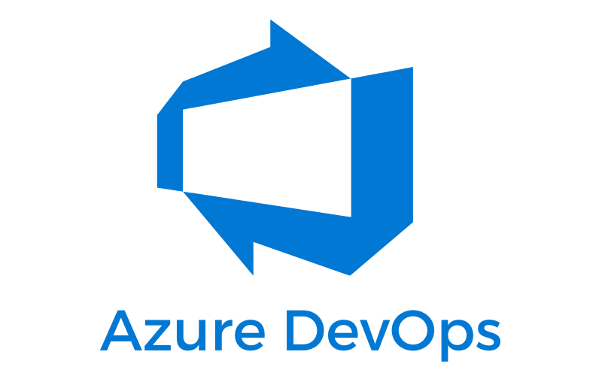




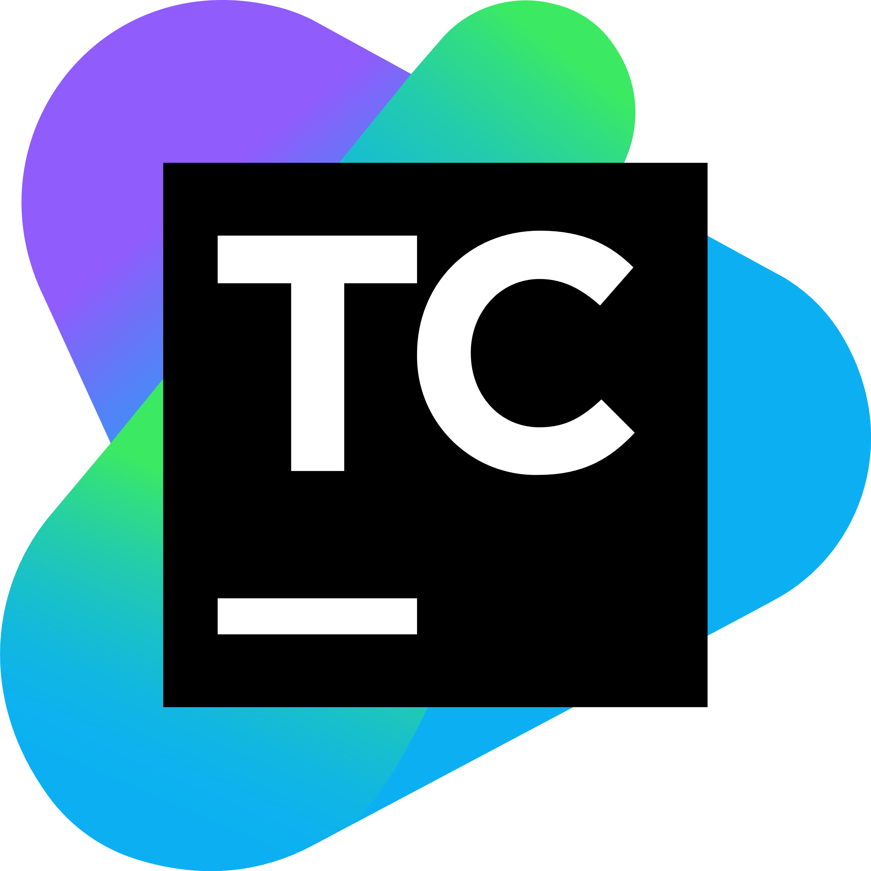
CI/CD Tools
GitHub Actions
Octopus Deploy
Bitbucket CI/CD
TeamCity
Jenkins

Slide 14
CI/CD Tools
GitHub Actions
Octopus Deploy
Bitbucket CI/CD
TeamCity
Jenkins

Slide 15
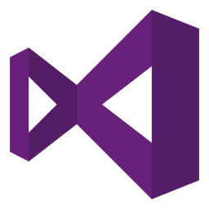
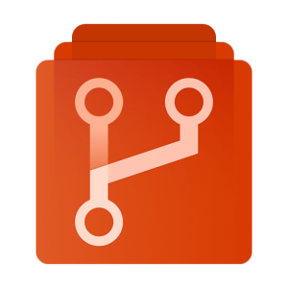





Azure DevOps – DevOps Workflow
Push and Pull Requests
Trigger Release Pipeline
Trigger Build
Pipeline
Visual Studio or VS Code
Azure DevOps
Repos
Azure DevOps
Build Pipelines
Azure DevOps
Release Pipelines
Deploy
Write code
Deployment Slot
Monitor
Log
Approve
Developers
App Insights
Web App (Prod)
Web App (UAT)

Slide 16
Azure DevOps – Repos
Visual Studio or VS Code
Azure DevOps
Repos
Azure DevOps
Build Pipelines
Azure DevOps
Release Pipelines
Deployment Slot
Developers
App Insights
Web App (Prod)
Web App (UAT)

Slide 17
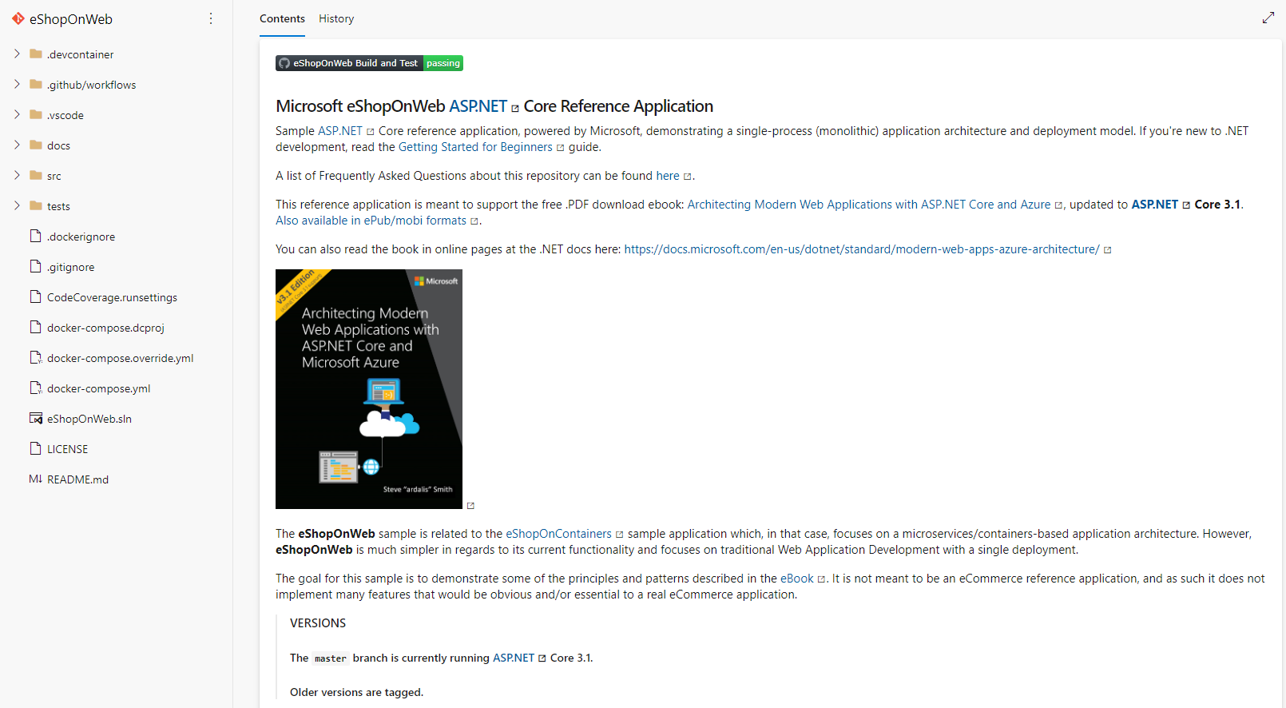
Azure DevOps – Repos
We will be using a sample ASP.NET Core web application for this exercise. The repo has already been cloned to the exercise Azure DevOps repo.
Source: https://github.com/dotnet-architecture/eShopOnWeb

Slide 18

Azure DevOps – Branching Strategy
Has anyone tried any other branching strategies?
Feature branching
master
feature/ description
bugfix/ description
After you’ve selected what branching strategy your team should use, you’ll need to implement branch policies to ensure that the team sticks to that strategy.
Read more on different types of branching strategies here.

Slide 19
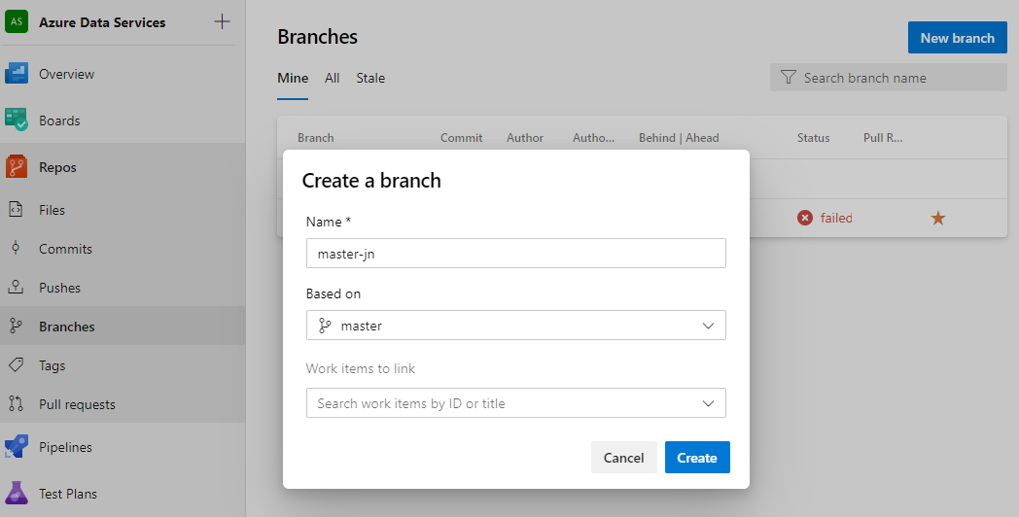

Azure DevOps – Branching Strategy
Let’s now create our own master branches for the exercises later by using the branch name: “master-<your initials>”.
2
We are only creating multiple master branches for this exercise to avoid merge conflicts as we will be changing same lines of code and merging it to master. In practice, this should not be done!
3
1
4

Slide 20
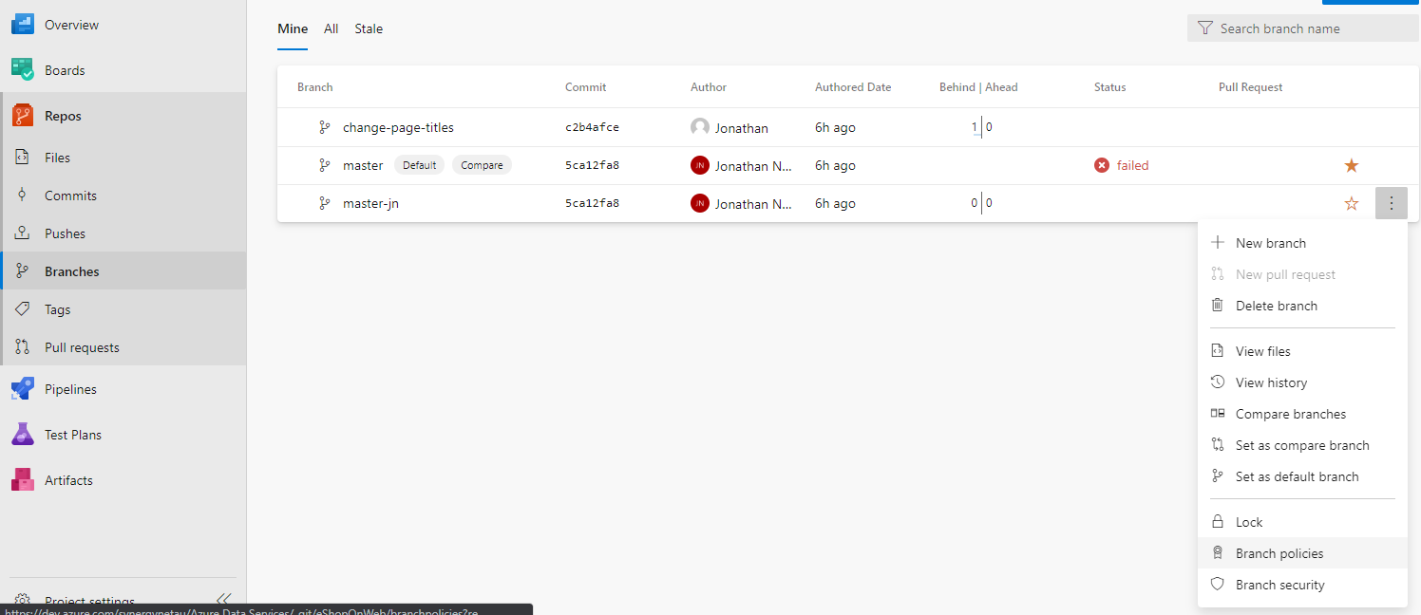
Azure DevOps – Repos – Branch Policies
Find the branch you have just created and select the ellipse “…” and select “Branch policies”

Slide 21
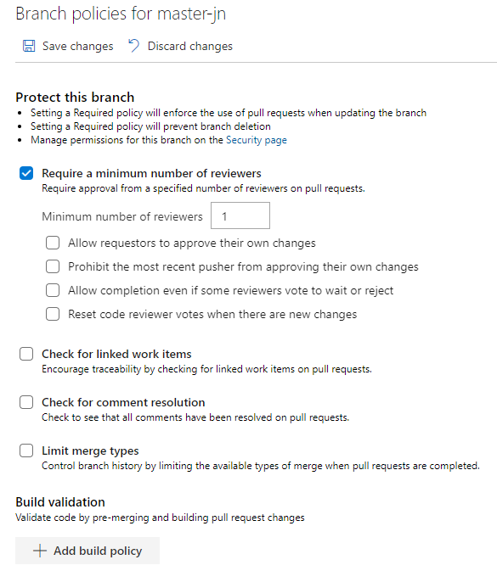
Azure DevOps – Repos – Branch Policies
Set the number of reviewers to “1”. This will also enforce the use of pull requests when updating the branch
When your changes are done, remember to save it
We’ll update Build validation later. For now just take note of it.

Slide 22

Azure DevOps – Repos
Can everyone please pull their master-<your initial> branch to your local repository now?
terminal
> git clone <url>

Slide 23
Azure DevOps – Build Pipelines
Visual Studio or VS Code
Azure DevOps
Repos
Azure DevOps
Build Pipelines
Azure DevOps
Release Pipelines
Deployment Slot
Developers
App Insights
Web App (Prod)
Web App (UAT)

Slide 24

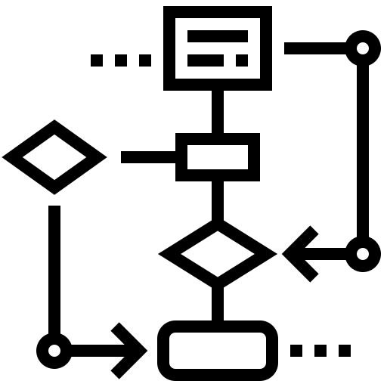
Azure DevOps – Build Pipelines
YAML
Yet Another Markdown Language
Code
Checked into source control and go through review process (PR)
Classic Pipelines
Created via a GUI
Easier to use (we’ll be using this for our exercises so that we can learn the concepts)

Slide 25
Azure DevOps – Build Pipelines
YAML
Yet Another Markdown Language
Code
Checked into source control and go through review process (PR)
Classic Pipelines
Created via a GUI
Easier to use (we’ll be using this for our exercises so that we can learn the concepts)

Slide 26
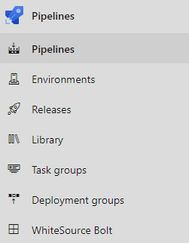
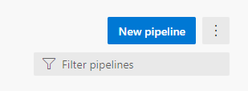
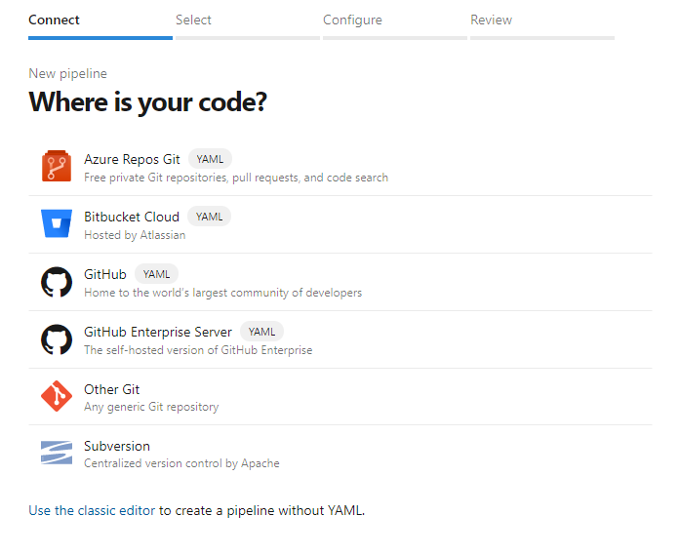
Azure DevOps – Build Pipelines
2
1
3

Slide 27
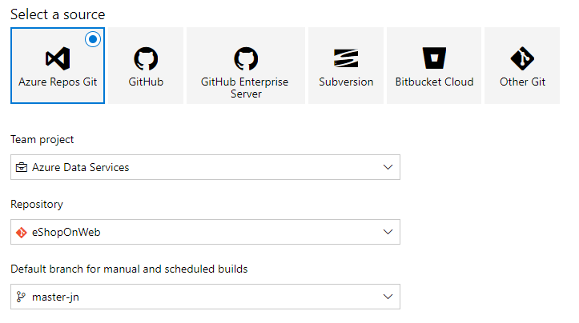
Azure DevOps – Build Pipelines
Select the master-<your initials> branch
4

Slide 28
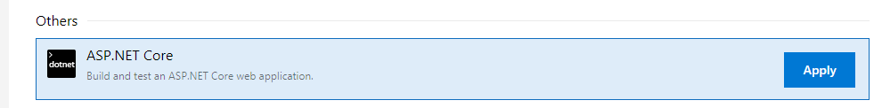
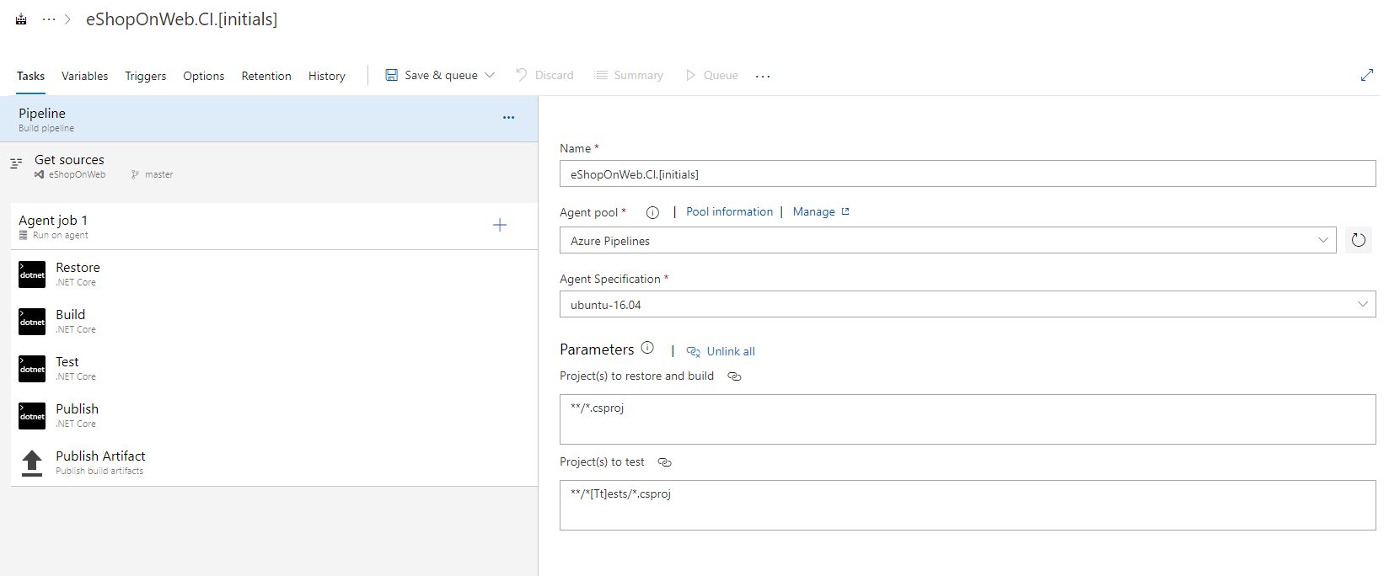
Azure DevOps – Build Pipelines
5
Replace [initials] with your initials
6

Slide 29
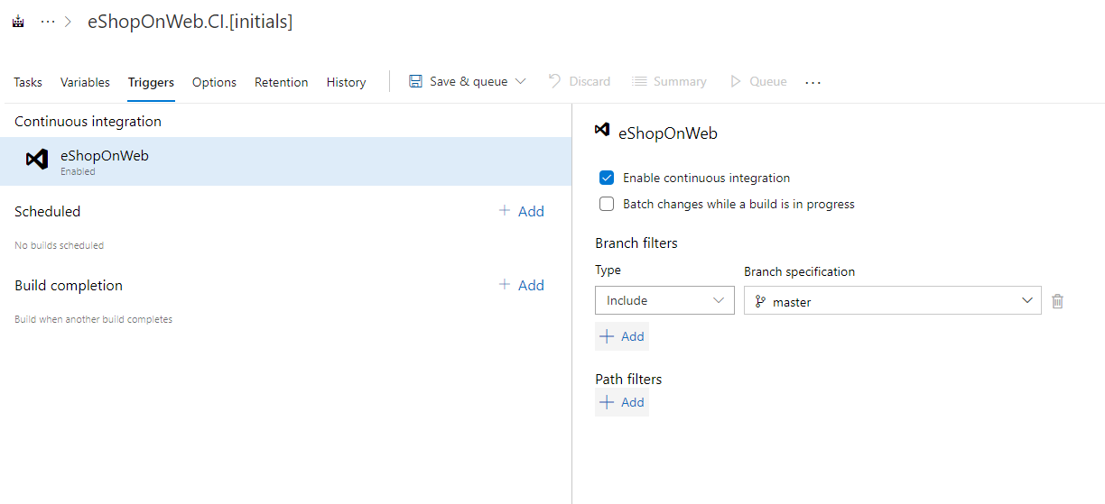
Azure DevOps – Build Pipelines
Select “Enable continuous integration”
7

Slide 30
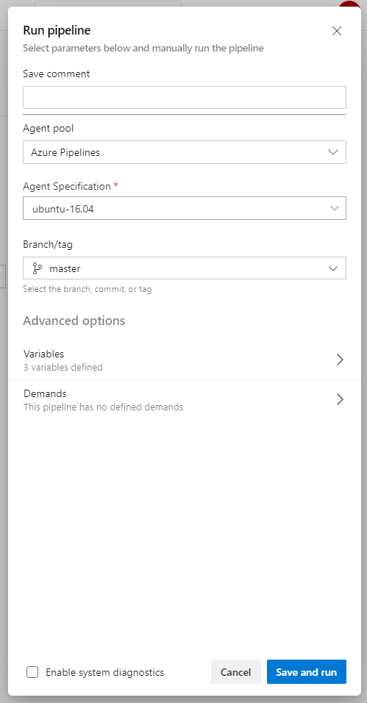
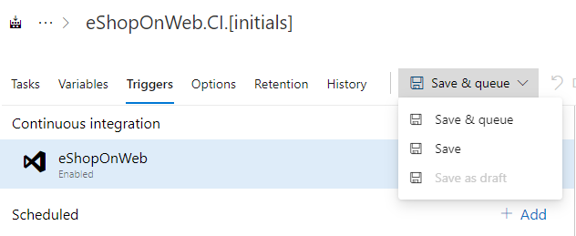
Azure DevOps – Build Pipelines
8
9

Slide 31
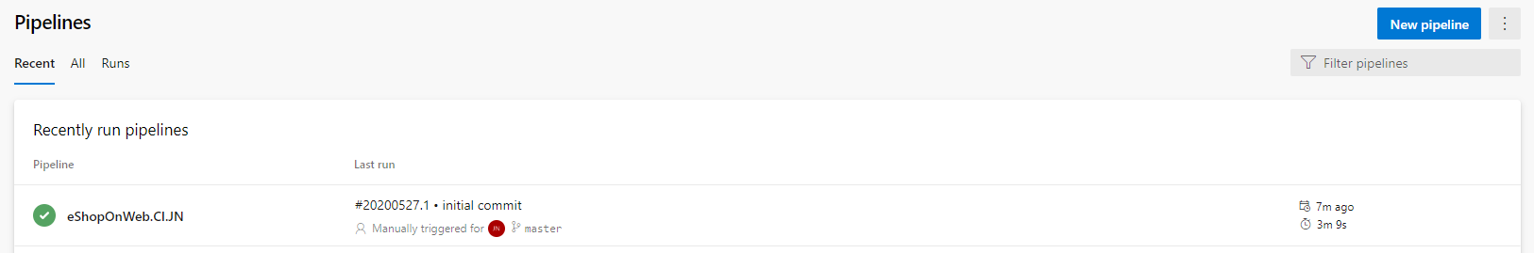
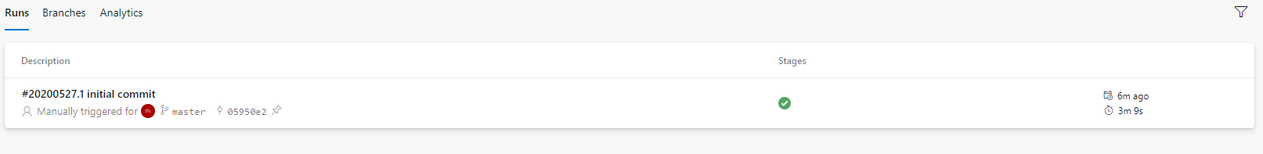
Azure DevOps – Build Pipelines
After run is complete:
Select the pipeline
Select the most recent run

Slide 32
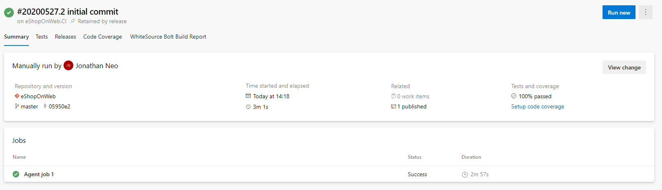
Azure DevOps – Build Pipelines
View the completed run

Slide 33
Azure DevOps – Build Pipelines
Select the job

Slide 34
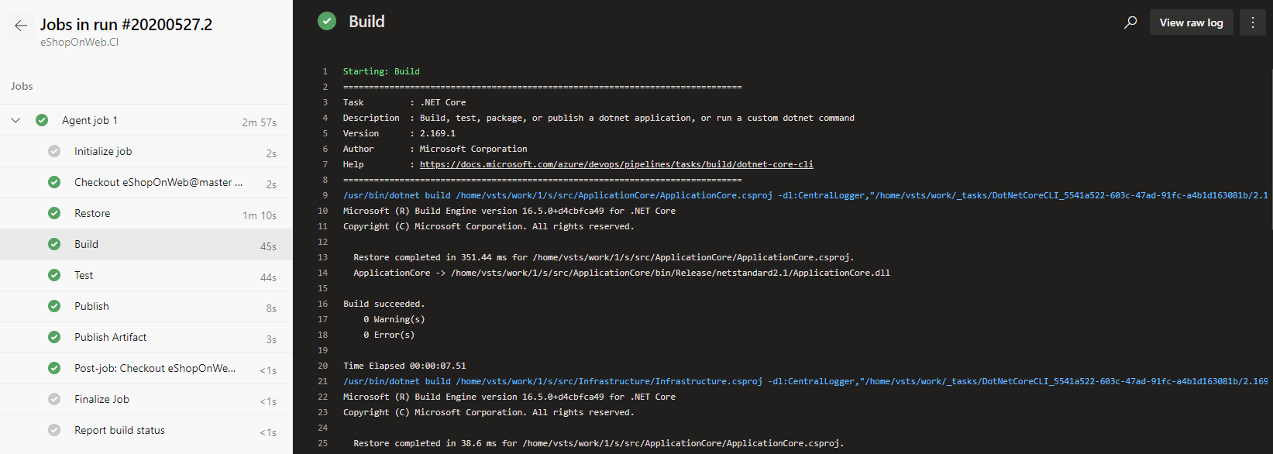
Azure DevOps – Build Pipelines
View the job logs

Slide 35
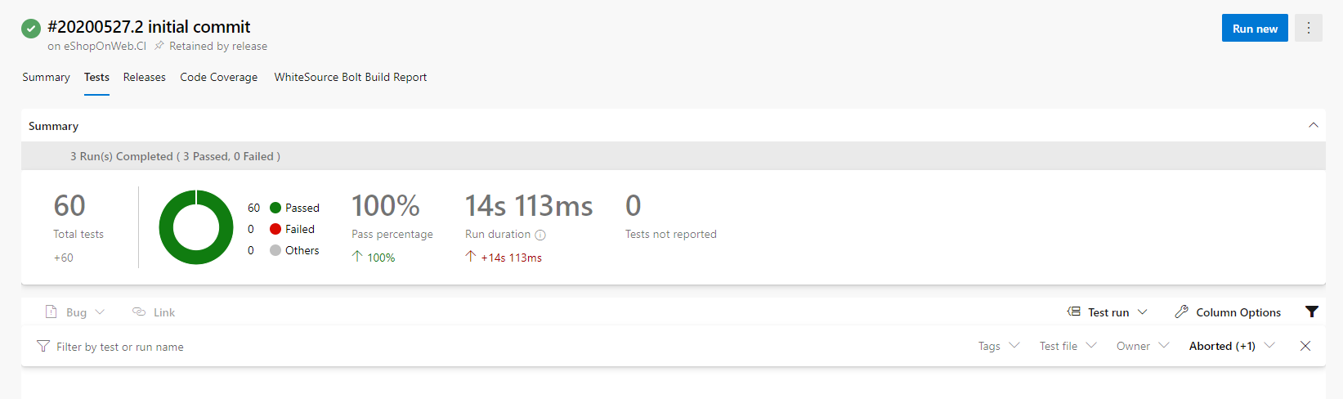
Azure DevOps – Build Pipelines
View the test summary

Slide 36
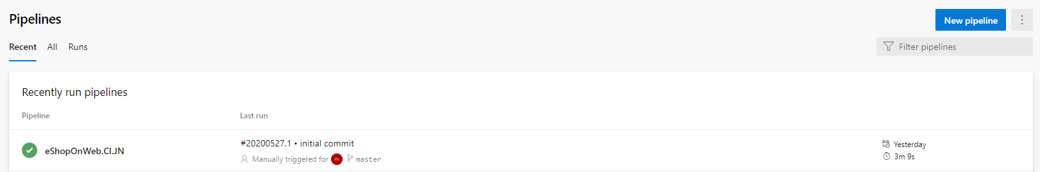
Azure DevOps – Build Pipelines
Let’s now clone our build pipeline so that it can be used for the build validation policy.
Select the build pipeline

Slide 37
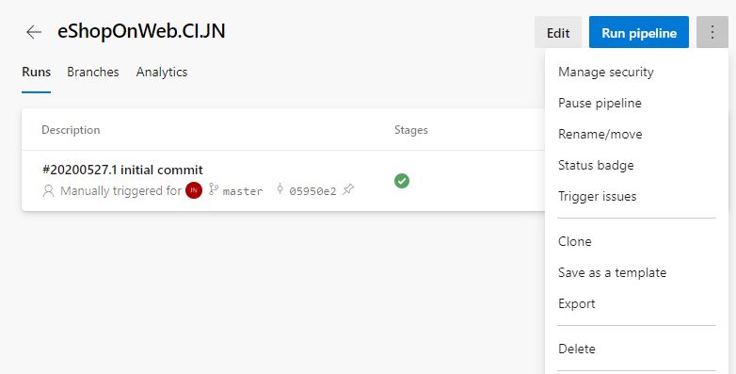
Azure DevOps – Build Pipelines

Slide 38
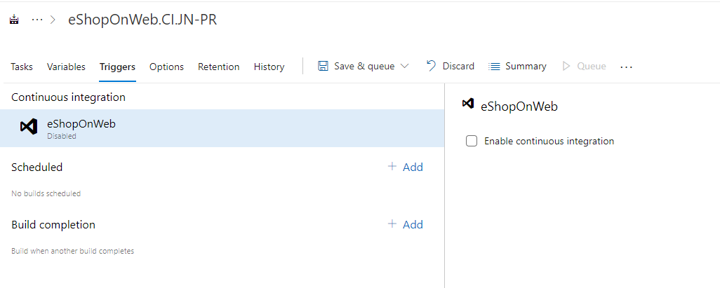
Azure DevOps – Build Pipelines
Disable “Continuous integration”

Slide 39
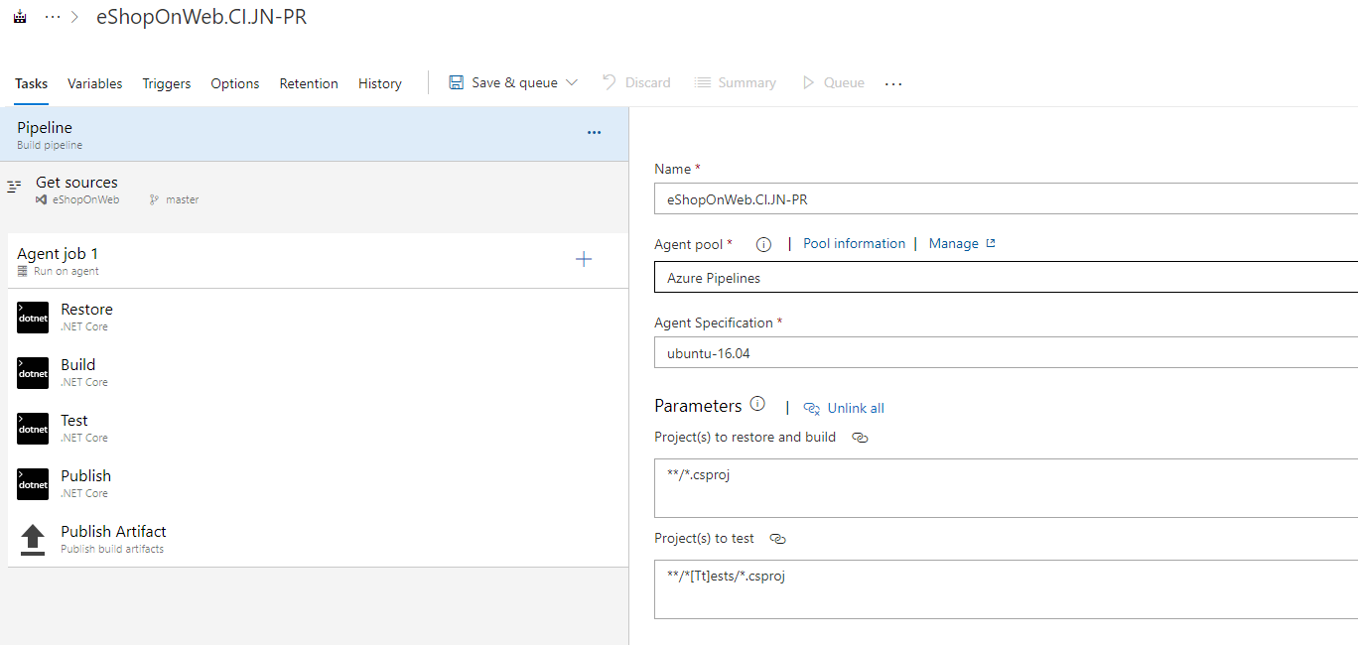
Azure DevOps – Build Pipelines
Append a “-PR” for Pull Request to the end of the build pipeline name

Slide 40
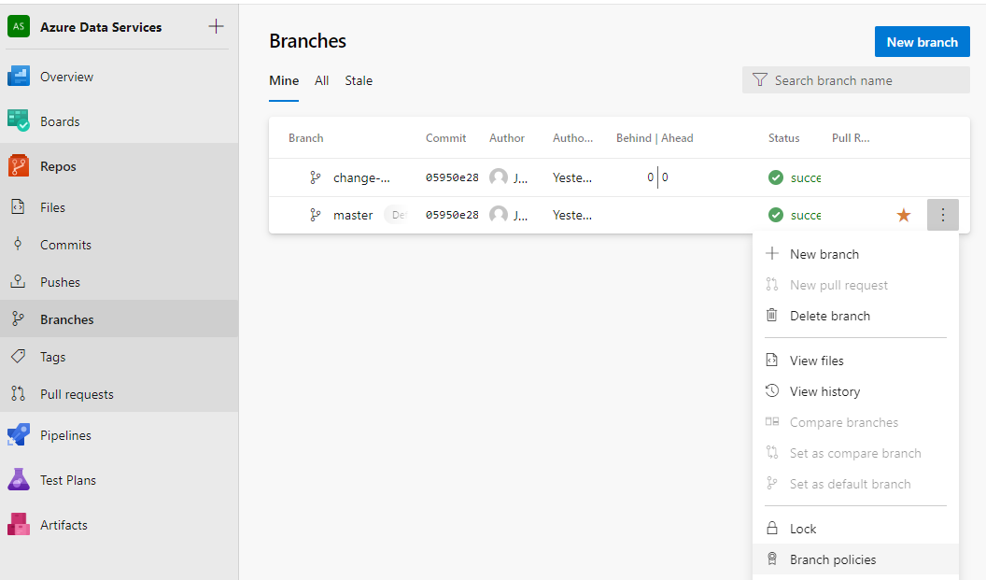
Azure DevOps – Build Pipelines
Select the ellipse “…” next to the master branch
Select branch policies

Slide 41
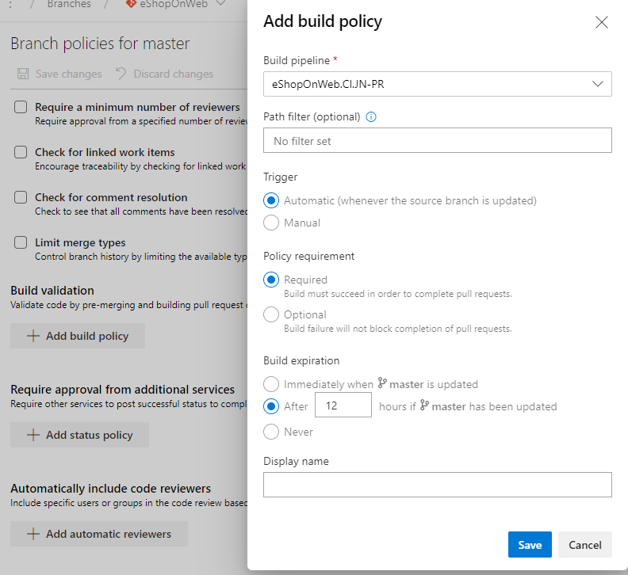
Azure DevOps – Build Pipelines
Select the “-PR” build pipeline we just created
Select Add build policy

Slide 42
Azure DevOps – Create web app resource
Visual Studio or VS Code
Azure DevOps
Repos
Azure DevOps
Build Pipelines
Azure DevOps
Release Pipelines
Deployment Slot
Developers
App Insights
Web App (Prod)
Web App (UAT)

Slide 43
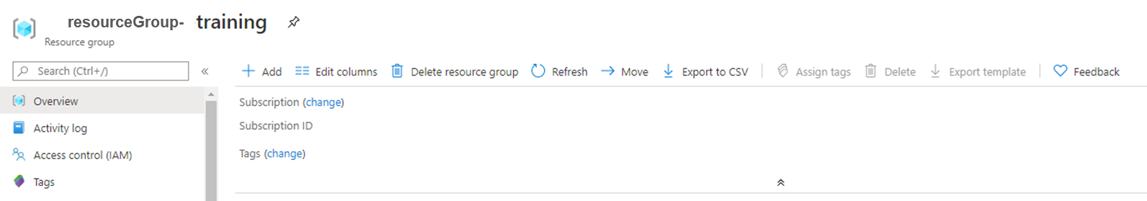
Azure DevOps – Create web app resource
Navigate to the training resource group
1

Slide 44
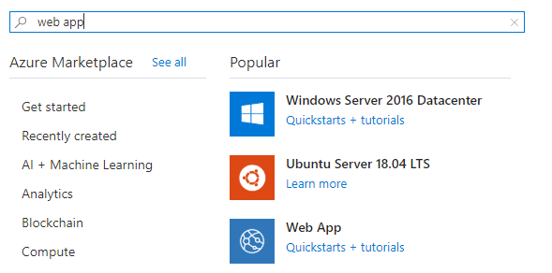
Azure DevOps – Create web app resource
Search for “web app”
2

Slide 45
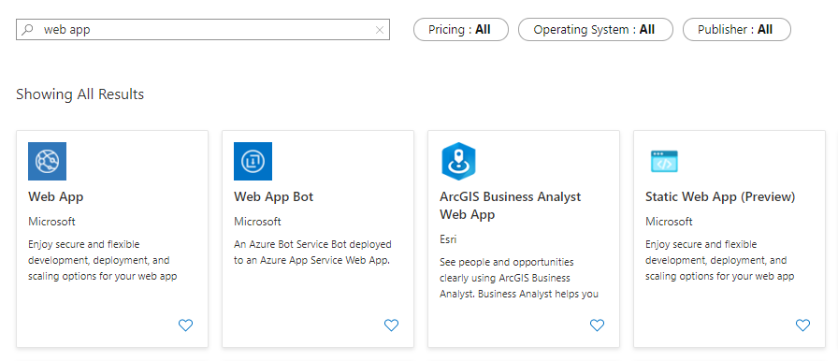
Azure DevOps – Create web app resource
Select “Web App”
3

Slide 46
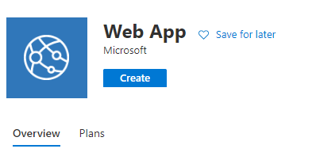
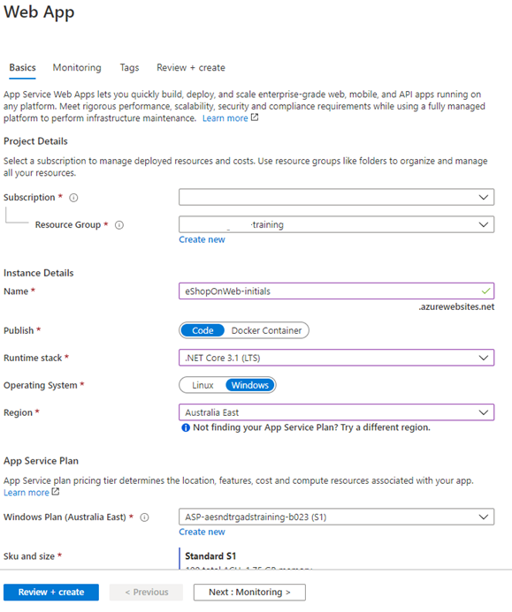
Azure DevOps – Create web app resource
4
Verify subscription and resource group
Replace “initials” with your initials. May need to enter random text to generate a unique name
Select Runtime stack: “.NET Core 3.1 (LTS)”
Select “S1” tier
5

Slide 47
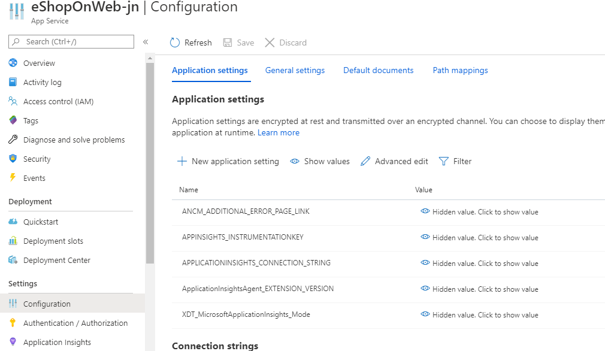
Azure DevOps – Create web app resource
7
6

Slide 48
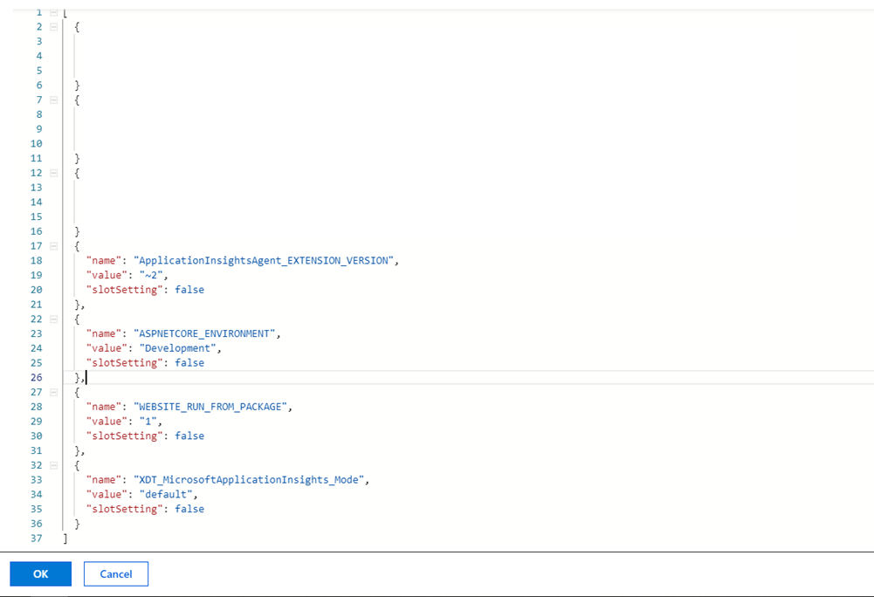
Azure DevOps – Create web app resource
Add in the following code:
{
"name": "ASPNETCORE_ENVIRONMENT",
"value": "Development",
"slotSetting": false
}

Slide 49
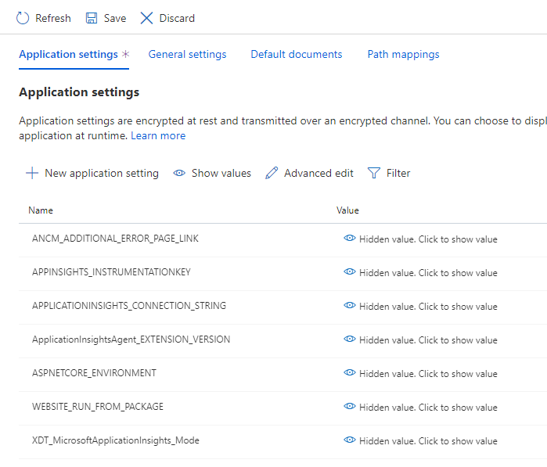
Azure DevOps – Create web app resource
8

Slide 50
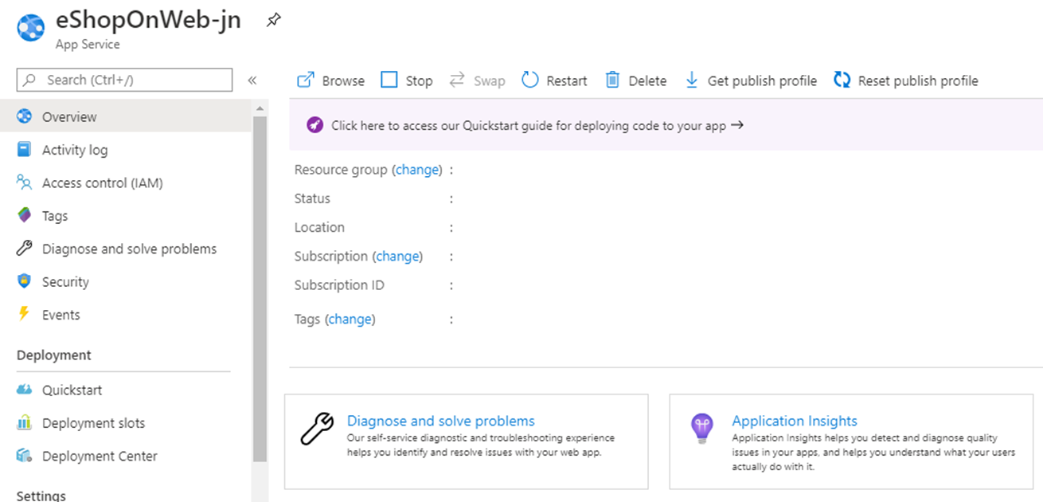
Azure DevOps – Create web app resource
9

Slide 51
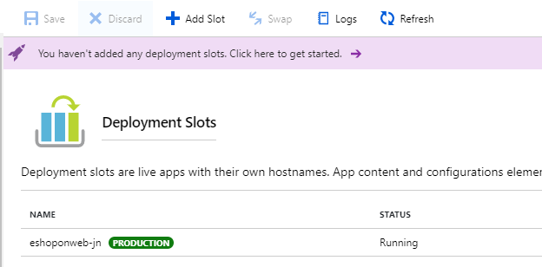
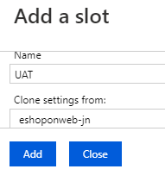
Azure DevOps – Create web app resource
10
Give slot the name “UAT” and clone settings from production
11
More info on deployment slots here. S1 pricing plan has up to 5 deployment slots.

Slide 52
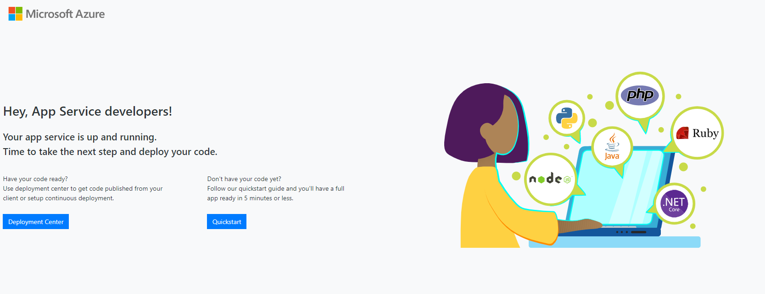
Azure DevOps – Create web app resource
Try accessing your web app now by using the URL provided in the Overview panel. You should see the following page below as you haven’t deployed any code to the web app resource.

Slide 53
Azure DevOps – Release Pipelines
Visual Studio or VS Code
Azure DevOps
Repos
Azure DevOps
Build Pipelines
Azure DevOps
Release Pipelines
Deployment Slot
Developers
App Insights
Web App (Prod)
Web App (UAT)

Slide 54
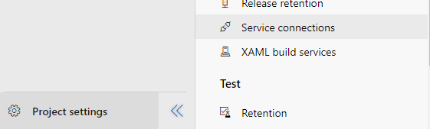
Azure DevOps – Release Pipelines
First, we need to create a service connection. A service connection is used to connect to an Azure Subscription and Resource Group so that you can deploy resources to it.
2
1
More info on service connections here.

Slide 55
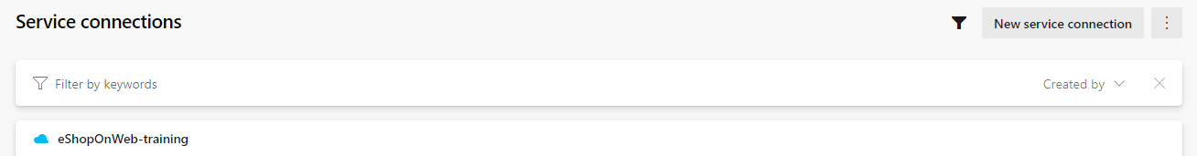


Azure DevOps – Release Pipelines
3
5
4

Slide 56

Azure DevOps – Release Pipelines
Choose appropriate subscription and resource group
Provide a service connection name

Slide 57



Azure DevOps – Release Pipelines
Now that we have created a service connection, let’s create a release pipeline and use the service connection to deploy our code to the web app resource.
2
1
3

Slide 58

Azure DevOps – Release Pipelines
4
Rename the stage to “UAT”

Slide 59

Azure DevOps – Release Pipelines
Replace [initials] with your initials
UAT

Slide 60

Azure DevOps – Release Pipelines

Slide 61

Azure DevOps – Release Pipelines
Select the build pipeline you created previously

Slide 62


Azure DevOps – Release Pipelines
Enable continuous deployment every time a new build is available
Select the Continuous Deployment Trigger

Slide 63

Azure DevOps – Release Pipelines
You are currently configuring the Stage settings
5
Select the service connection that was created for this exercise
UAT
Select the app service name that you created

Slide 64



Azure DevOps – Release Pipelines
7
6
Rename stage to “Production”

Slide 65


Azure DevOps – Release Pipelines
8
9
Search and add “Azure App Service manage”
10

Slide 66

Azure DevOps – Release Pipelines
Populate the missing fields
Swap UAT with Production

Slide 67

Azure DevOps – Release Pipelines
Select Pre-Deployment Conditions (only for Production)

Slide 68

Azure DevOps – Release Pipelines
Enable Pre-deployment approval and select a person or group of your choice

Slide 69

Azure DevOps – Release Pipelines
11
Training
12

Slide 70


Azure DevOps – Release Pipelines
13
Review the release information
Provide an optional release description
14

Slide 71

Azure DevOps – Release Pipelines
Verify that the deployment succeeded

Slide 72

Azure DevOps – Release Pipelines
View logs of the run by clicking on the detailed logs

Slide 73

Azure DevOps – Release Pipelines
Verify that you can access the web application

Slide 74
Azure DevOps – DevOps Workflow
Visual Studio or VS Code
Azure DevOps
Repos
Azure DevOps
Build Pipelines
Azure DevOps
Release Pipelines
Let’s now review the end-to-end DevOps workflow that we have just created
Deployment Slot
Developers
App Insights
Web App (Prod)
Web App (UAT)

Slide 75
Azure DevOps – DevOps Workflow
Visual Studio or VS Code
Azure DevOps
Repos
Azure DevOps
Build Pipelines
Azure DevOps
Release Pipelines
The developer makes a change to the code and commit their changes to a feature branch
Write code
Deployment Slot
Developers
App Insights
Web App (Prod)
Web App (UAT)

Slide 76
Azure DevOps – DevOps Workflow
Push and Pull Requests
Visual Studio or VS Code
Azure DevOps
Repos
Azure DevOps
Build Pipelines
Azure DevOps
Release Pipelines
They will then push their changes to the remote repository and perform a pull request to bring changes from a feature branch to the master branch. The build validation will need to pass (including test cases) and a reviewer will need to approve before the merge can complete.
Deployment Slot
Developers
App Insights
Web App (Prod)
Web App (UAT)

Slide 77
Azure DevOps – DevOps Workflow
Trigger Build
Pipeline
Visual Studio or VS Code
Azure DevOps
Repos
Azure DevOps
Build Pipelines
Azure DevOps
Release Pipelines
Once the build validation passes and the pull request is approved and complete, it will trigger an automated build
Deployment Slot
Developers
App Insights
Web App (Prod)
Web App (UAT)

Slide 78

Azure DevOps – DevOps Workflow
Continuous Integration
Visual Studio or VS Code
Azure DevOps
Repos
Azure DevOps
Build Pipelines
Azure DevOps
Release Pipelines
Deployment Slot
Developers
App Insights
Web App (Prod)
Web App (UAT)

Slide 79
Azure DevOps – DevOps Workflow
Trigger Release Pipeline
Visual Studio or VS Code
Azure DevOps
Repos
Azure DevOps
Build Pipelines
Azure DevOps
Release Pipelines
When the build is complete, it will trigger the release pipeline automatically
Deployment Slot
Developers
App Insights
Web App (Prod)
Web App (UAT)

Slide 80
Azure DevOps – DevOps Workflow
The release pipeline will automatically deploy the web application to the UAT deployment slot
Visual Studio or VS Code
Azure DevOps
Repos
Azure DevOps
Build Pipelines
Azure DevOps
Release Pipelines
Deploy
Deployment Slot
Developers
App Insights
Web App (Prod)
Web App (UAT)

Slide 81
Azure DevOps – DevOps Workflow
The tester will perform UAT and once all tests have passed, the approver can approve deployment to production deployment slot
Visual Studio or VS Code
Azure DevOps
Repos
Azure DevOps
Build Pipelines
Azure DevOps
Release Pipelines
Deployment Slot
Approve
Developers
App Insights
Web App (Prod)
Web App (UAT)

Slide 82
Azure DevOps – DevOps Workflow
Continuous Deployment
Visual Studio or VS Code
Azure DevOps
Repos
Azure DevOps
Build Pipelines
Azure DevOps
Release Pipelines
Deployment Slot
Approve
Developers
App Insights
Web App (Prod)
Web App (UAT)

Slide 83
Azure DevOps – DevOps Workflow
Visual Studio or VS Code
The end-user’s usage stats will then be logged to App Insights
Azure DevOps
Repos
Azure DevOps
Build Pipelines
Azure DevOps
Release Pipelines
Deployment Slot
Log
Developers
App Insights
Web App (Prod)
Web App (UAT)

Slide 84
Azure DevOps – DevOps Workflow
Visual Studio or VS Code
The Development Team can review the end-user’s usage patterns (end-user feedback) and decide what features to add to the next sprint’s backlog
Azure DevOps
Repos
Azure DevOps
Build Pipelines
Azure DevOps
Release Pipelines
Deployment Slot
Monitor
Developers
App Insights
Web App (Prod)
Web App (UAT)

Slide 85
Azure DevOps – DevOps Workflow
Deploy
DEV
OPS
Feedback

Slide 86
Azure DevOps – DevOps Workflow
Deploy
Perform a deployment to production at the end of each sprint if possible
DEV
OPS
Feedback

Slide 87
Azure DevOps – Incremental Changes
DevOps provides development teams with the capability to release code in an incremental fashion, thus lowering the amount of change/risk
Traditional Software Development
DevOps-led Software Development

Slide 88
Azure DevOps – DevOps Workflow Exercise
Visual Studio or VS Code
Azure DevOps
Repos
Azure DevOps
Build Pipelines
Azure DevOps
Release Pipelines
Let’s make a change to the code and observe the end-to-end workflow
Deployment Slot
Developers
App Insights
Web App (Prod)
Web App (UAT)

Slide 89
Azure DevOps – DevOps Workflow Exercise
Navigate to:
eShopOnWeb
_Layout.cshtml
src
<title>@ViewData["Title"] - Microsoft.eShopOnWeb</title>
Web
Views
Shared
_Layout.cshtml

Slide 90
Azure DevOps – DevOps Workflow Exercise
Navigate to:
eShopOnWeb
_Layout.cshtml
src
<title>@ViewData["Title"] - <Your_Name> eShop </title>
Web
Views
Shared
_Layout.cshtml

Slide 91
Azure DevOps – DevOps Workflow Exercise
Commit change to a local feature branch called change-title-<your initials>
Push local branch to remote
Create a pull request to remote master-<your initials> and add a reviewer
Wait for reviewer to approve and for build validation to succeed
Complete the pull request
Observe an automated build is triggered and wait for it to complete
Observe an automated release is created and wait for it to complete deployment to UAT slot
Wait for approver to approve deployment to production slot
Deployment to production slot complete

Slide 92

Course Complete!

Slide 93
Resources
Resource | URL
Introduction to DevOps | https://channel9.msdn.com/Series/DevOps-Fundamentals/Introduction-to-DevOps?term=devops&lang-en=true
Automated Testing | https://channel9.msdn.com/Series/DevOps-Fundamentals/Automated-Testing
Unit testing for databases | https://channel9.msdn.com/Shows/DevOps-Lab/Unit-Testing-your-Database-Changes?term=database%20testing&lang-en=true
Continuous Integration | https://channel9.msdn.com/Series/DevOps-Fundamentals/Continuous-Integration
Continuous Deployment | https://channel9.msdn.com/Series/DevOps-Fundamentals/Continuous-Deployment-and-Release-Management

Slide 94
References
Resource | URL
Icons from Pixel Perfect | https://www.flaticon.com/authors/pixel-perfect
Icons from Freepik | https://www.flaticon.com/authors/freepik

Slide 95
Thank you

